Slide 1
I-80 Coalition
UDOT Presentation
Kevin E. Griffin P.E.
Director of Maintenance
Utah Department of Transportation

Slide 2
Outline
RWIS Upgrades.
Snow and Ice Performance Measure
DAQ PM 2.5 Requirements.

Slide 3
RWIS Upgrades

Slide 4
RWIS Upgrades
Current system in need of upgrades.
TOC and Central Maintenance funded.
Looking at potential new locations.

Slide 5
RWIS Upgrades
Upgrading all existing RWIS stations.
New road puck installations.
Upgrading old instrumentation.

Slide 6
Snow and Ice Performance Measure

Slide 7
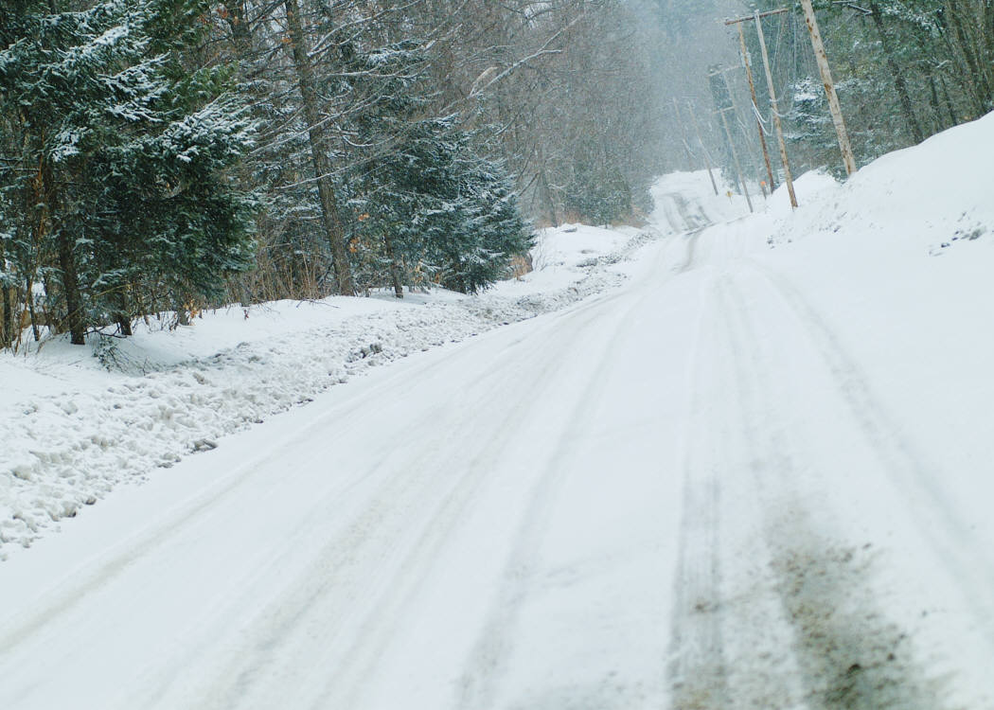
Snow and Ice Performance Measure
Develop new performance measure around upgraded RWIS stations
Factors:
          Salinity
          Road Temp
          Air Temp
          Relative Humidity

Slide 8
Snow and Ice Performance Measure
Real-time data.
Idaho Transportation Department.
          Developed a formula using RWIS sensors to reflect ice on the road.
          Allowing UDOT to use their formula.
        UDOT will develop a modified formula.

Slide 9
Snow and Ice Performance Measure
Removes subjectivity.
New performance measure will replace current MMQA measure.
Will be used statewide.
Give UDOT consistent measure.
Better understand funding needed to maintain specific performance levels.

Slide 10
DAQ PM 2.5 Requirements

Slide 11
DAQ PM 2.5 Requirements
Expanded to include additional areas.
Will include more of I-80.
Cannot use grit unless removed from roadway.
Require special approval to not remove.
Can be waved in cases of emergency.

